Slide 1
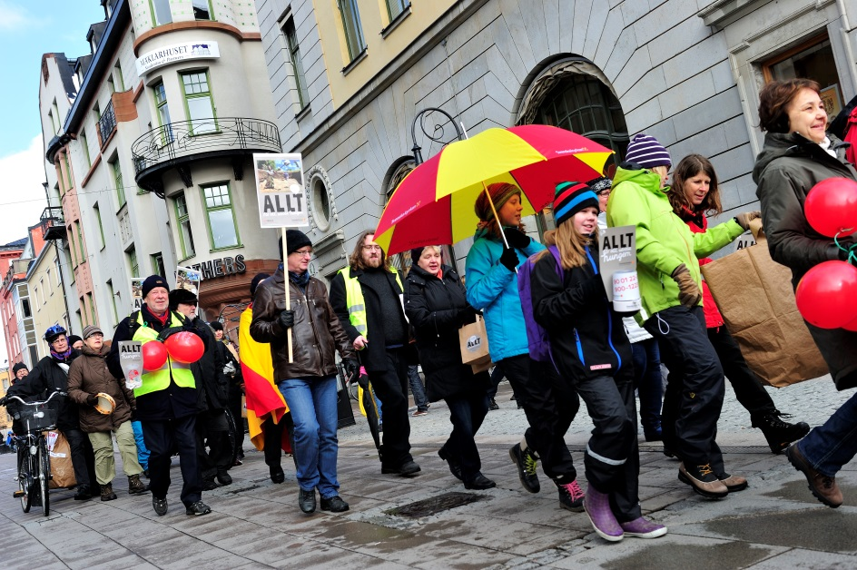
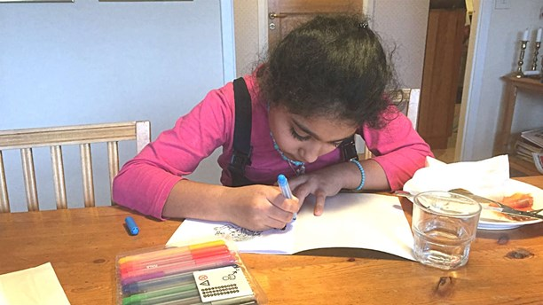
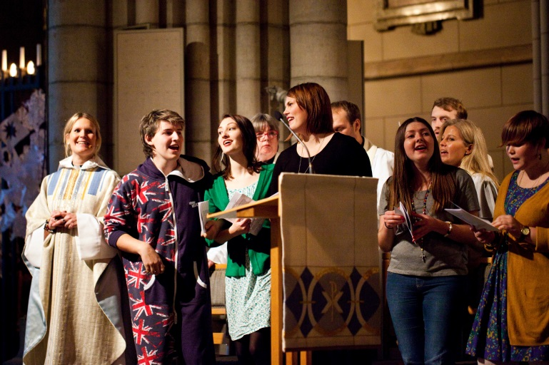
Church of Sweden

Slide 2
Investing in children, how breaking the cycle of poverty?
Introduction
Church of Sweden project - Digniti Omnia
Meeting the children

Slide 3
Our identity
Our assignment
For the sake of life and together in the worldwide church, God sends us, in our words and actions, to share the Gospel, defend human dignity, safeguard the Creation and live in faith, hope and love.

Slide 4
Our identity
Our assignment
For the sake of life and together in the worldwide church, God sends us, in our words and actions, to share the Gospel, defend human dignity, safeguard the Creation and live in faith, hope and love.

Slide 5
Our identity
Our assignment
For the sake of life and together in the worldwide church, God sends us, in our words and actions, to share the Gospel, defend human dignity, safeguard the Creation and live in faith, hope and love.

Slide 6
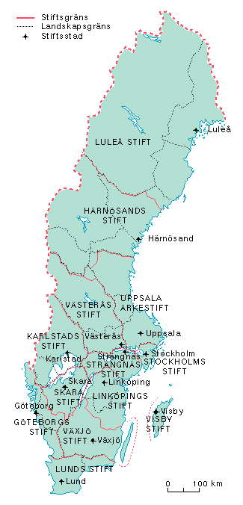
Where we work
Who we are
is an Evangelical Lutheran church
… has around 6.5. million members
… had 1426 parishes at the beginning of 2013
… has a three-pronged structure: parish, diocese and national level. The Central Church Office in Uppsala comprises the national level.

Slide 7
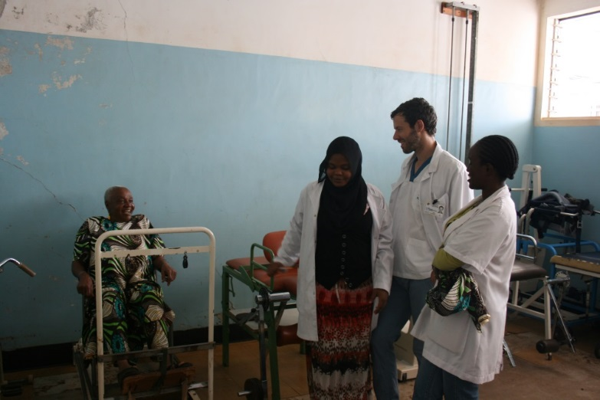
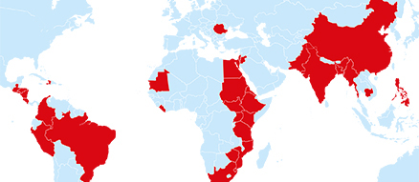
Where we work
Who we are

Slide 8
International and national project
Roman in Romania
Digniti Omnia in Sweden

Slide 9
Who we are
Digniti Omnia – A life of dignity for everyone

Slide 10
Outlook
Almost every fifth child in the European union, are considered poor according to EU standard.
Some of this children and their parents who lives in poverty and discrimination in their home countries (often Roma people from Romania and Bulgaria) tries to find income in other EU countries like Sweden.
In Sweden, with its extensive welfare system has not been able to find a solution for them, so the alternatives sometimes narrows down to begging

Slide 11
The Fead fund
Fead is a new fund in the programme period 2014-2020.
The EU budget for Fead is 3,8 billion Euro
Sweden’s part of the funds are 7,9 million euro.
The activities within the Swedish Fead is limited to social inclusion and health
Church of Swedens Project Digniti Omnia - a dignified life for everyone, is a one of the project funded by the FEAD.
The project Digniti Omnia was awarded funds from FEAD for the period 2014 - 2020.
Notes:
The project Digniti Omnia - a dignified life for everyone is a project funded by the EU fund for the most vulnerable (FEAD).
The project Digniti Omnia was awarded funds from the Fund for the period 2014 - 2020.

Slide 12
Target group
The main target group for the Fead programme in Sweden is vulnerable EU-citizens.
There are approximately 4700 individuals in Sweden.
In Digniti Omnia the focus is persons in the target group age of 16 and up and their families.

Slide 13
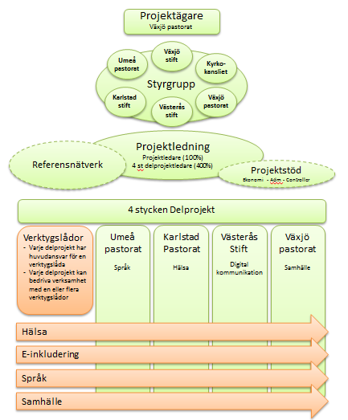
Project structure
Notes:
The project targets vulnerable EU citizens in Sweden and is run jointly by the parish Växjö, Karlstad pastorate, Umeå parish and the Diocese of Västerås. Project is Vaxjo parish. The aim of the project is to strengthen the vulnerable EU citizens to social inclusion and empowerment.
The project manager is from Vaxjo parish and has a European outlook, but the actual work is done locally with four subprojects.

Slide 14
The subprojects
Digniti Omnia consist of four subprojects, in different parts of Sweden, these are owned by different bodies within the Church of Sweden.
The Diocese of Västerås
The Parish of Karlstad
The Parish of Umeå
The Parish of Växjö

Slide 15
Subprojects– continued
Every subproject has a full – time project leader
Every subproject has a special responsibility in the Toolbox
Every subprojects is conducting activities with and for the target group (health awareness, mail-courses, language training information on civil rights etc.)
Every subproject engages volunteers and personal locally and regionally
Every subproject contributes to raise the awareness about the target group
Notes:
Every project has a full-time project manager who works with a special responsibility in the Toolbox: Umeå parish working with Language skills, Västerås working with digital communication (where Liselotte is coming from). Vaxjö parish working with the Civilsociety and finally Karlstad pastorate working with Health.

Slide 16
Toolkit
The project will develop a toolkit for the work with and for the target group, focusing on the four areas
Civil rights
Language
Health
Digital communications
Notes:
The project will develop a toolkit based on the four themes.

Slide 17
Effects of the project
The project aims of the following effects
Creating better possibilities for starting up activities and working with the EU-migrant group
Increased the cultural competence within the Church of Sweden concerning the target group

Slide 18
Children in Sweden

Slide 19
Thank you!
If you want to know more:
Liselott.m.andersson@svenskakyrkan.se
fredrik.schiren@svenskakyrkan.se

