Slide 1
European Semester Cycle:
Understanding the Autumn package and preparing next steps

Slide 2
Agenda
What is the European Semester?
Eurodiaconia Report and social policy priorities
Social Platform Guidance on Civil Society Involvement
2022 Autumn Package + Reaction
New European Semester process
How to get involved?

Slide 3
What is the European Semester and why is it important to us?
EU framework for the coordination of economic and employment policies
Structured discussion between the European Commission and Member States about fiscal, economic and employment challenges
Since 2011
Social issues increasingly part of the European Semester analysis
  Two frameworks:
  European Pillar of Social Rights and SDGs
Opportunities for civil society involvement at EU and national level
Notes:
European Pillar of Social Rights – 20 principles, three chapters: equal opportunities, fair working conditions, social protection
Action Plan + 3 Headline targets (skills, employment, poverty)
Monitoring through the JER

Slide 4
Our social policy priorities
Strengthening social services
Supporting long-term care services
Building on the Child Guarantee
Addressing poverty in all its forms
Supporting young people

Slide 5
Civil Society Involvement –
Social Platform Guidance Documents
EU Institutions
EU Member States
Formally recognise structured & regular civil dialogue in all Semester processes
Ensure regulatory & financial frameworks are empowering
Recognise & engage with the diversity of CSOs
Regularly collect data on the involvement of CSOs in the Semester process
Review Civil Dialogue in EU-policy development
Facilitate active outreach
Ensure regulatory & financial frameworks are empowering
Invest in building the capacity of civil society

Slide 6
2022 Autumn package
Some encouraging language in the ASGS on “sustainable, fair and inclusive recovery” and “leaving no one behind”
Section on “fairness” limited to labour market aspects
Social Pillar principles not equally covered
Social Scoreboard has been updated, but still doesn’t cover all principles
Social services not really addressed
Long-term care only in JER
Child poverty only in JER
NEETs – recognized problem
Poverty – in-work poverty and energy poverty recognized, homelessness not addressed
Notes:
LTC in a “focus box” – addressed mainly in view of improving labour market participation of women, not as a right + working conditions not addressed
Child poverty also in a “focus box” – focus on poverty levels and ECEC, no look at specific groups, such as children with migrant background or minorities – Child Guarantee mentioned, but no assessment yet
NEETs/ young people in both documents – numbers rised for the first time in 6 years – migrant background and young women particularly affected – strengthened Youth Guarantee, not a strong focus on outreach
Poverty overall, analysed on basis of AROPE indicators – poverty levels have broadly stayed stable in 2020

Slide 7
Eurodiaconia reaction
Recognize and support the work of social service providers
Take decisive action on long-term care
Strengthen attention to the vulnerable and leave no one behind
Strengthen structured civil dialogue
Notes:
Social service providers are key partners for the implementation of the EPSR – crucial to develop quality, affordable, accessible and adequate services – social investment – creation of quality jobs
LTC – should be a priority in ASGS – reform and investment needed – quality employment
Implementation of EPSR goes not without targeted support to vulnerable and persons facing multiple barriers and discrimination
Structured civil dialogue at EU and national level – knowledge about needs and issues on the ground

Slide 8
Questions ?
Any questions on the presented documents?

Slide 9
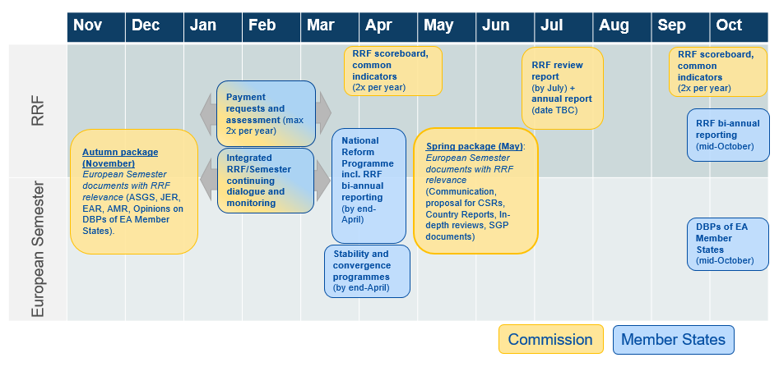

New European Semester process

Slide 10
How to get involved in the 2022 European Semester cycle
 | January - March | April | June | September
National level | Feed into NRPs: Written input Ask for meeting | Analyse NRPs
 | Meet with Ministry
EU level | Feed into Country Reports: Meeting on 17.02.22 Written input | What is missing in NRPs? | Webinar for members on Country Reports and CSRs | State of the Social Union Conference
 | Shadow CSRs |  | Reaction to Country Reports and CSRs | Input for Autumn package
Notes:
RRF review report – find out about knowledge in the membership on RRF

Slide 11
Questions or comments ?
Any questions on Eurodiaconia involvement ?
How are you planning to get involved ?

Slide 12
Thank you for your attention
www.eurodiaconia.org

