Slide 1
European Pillar of Social Rights
What does it mean for diaconal organisations and how to get involved?

Slide 2
Agenda
An introduction to the European Pillar of Social Rights
Linking diaconal work to the Pillar Principles
The Social Pillar Action Plan – Presentation and Q&A (Mr. Marcello Ranucci, Policy Officer– EMPL A.1)
The way forward – How can we, as a diaconal network, support the implementation of the Social Pillar?

Slide 3
The European Pillar of Social Rights
First announced in 2015 by Commission President Juncker
Launched in 2017
Upward social convergence
Eurodiaconia has been involved with the Pillar from the start
  2016 Public Consultation on the European Pillar of Social Rights
  Advocating for the importance of social service provision in advancing and fulfilling the principles of the Pillar
Notes:
European Pillar of Social Rights – 20 principles, three chapters: equal opportunities, fair working conditions, social protection
Action Plan + 3 Headline targets (skills, employment, poverty)
Monitoring through the JER

Slide 4
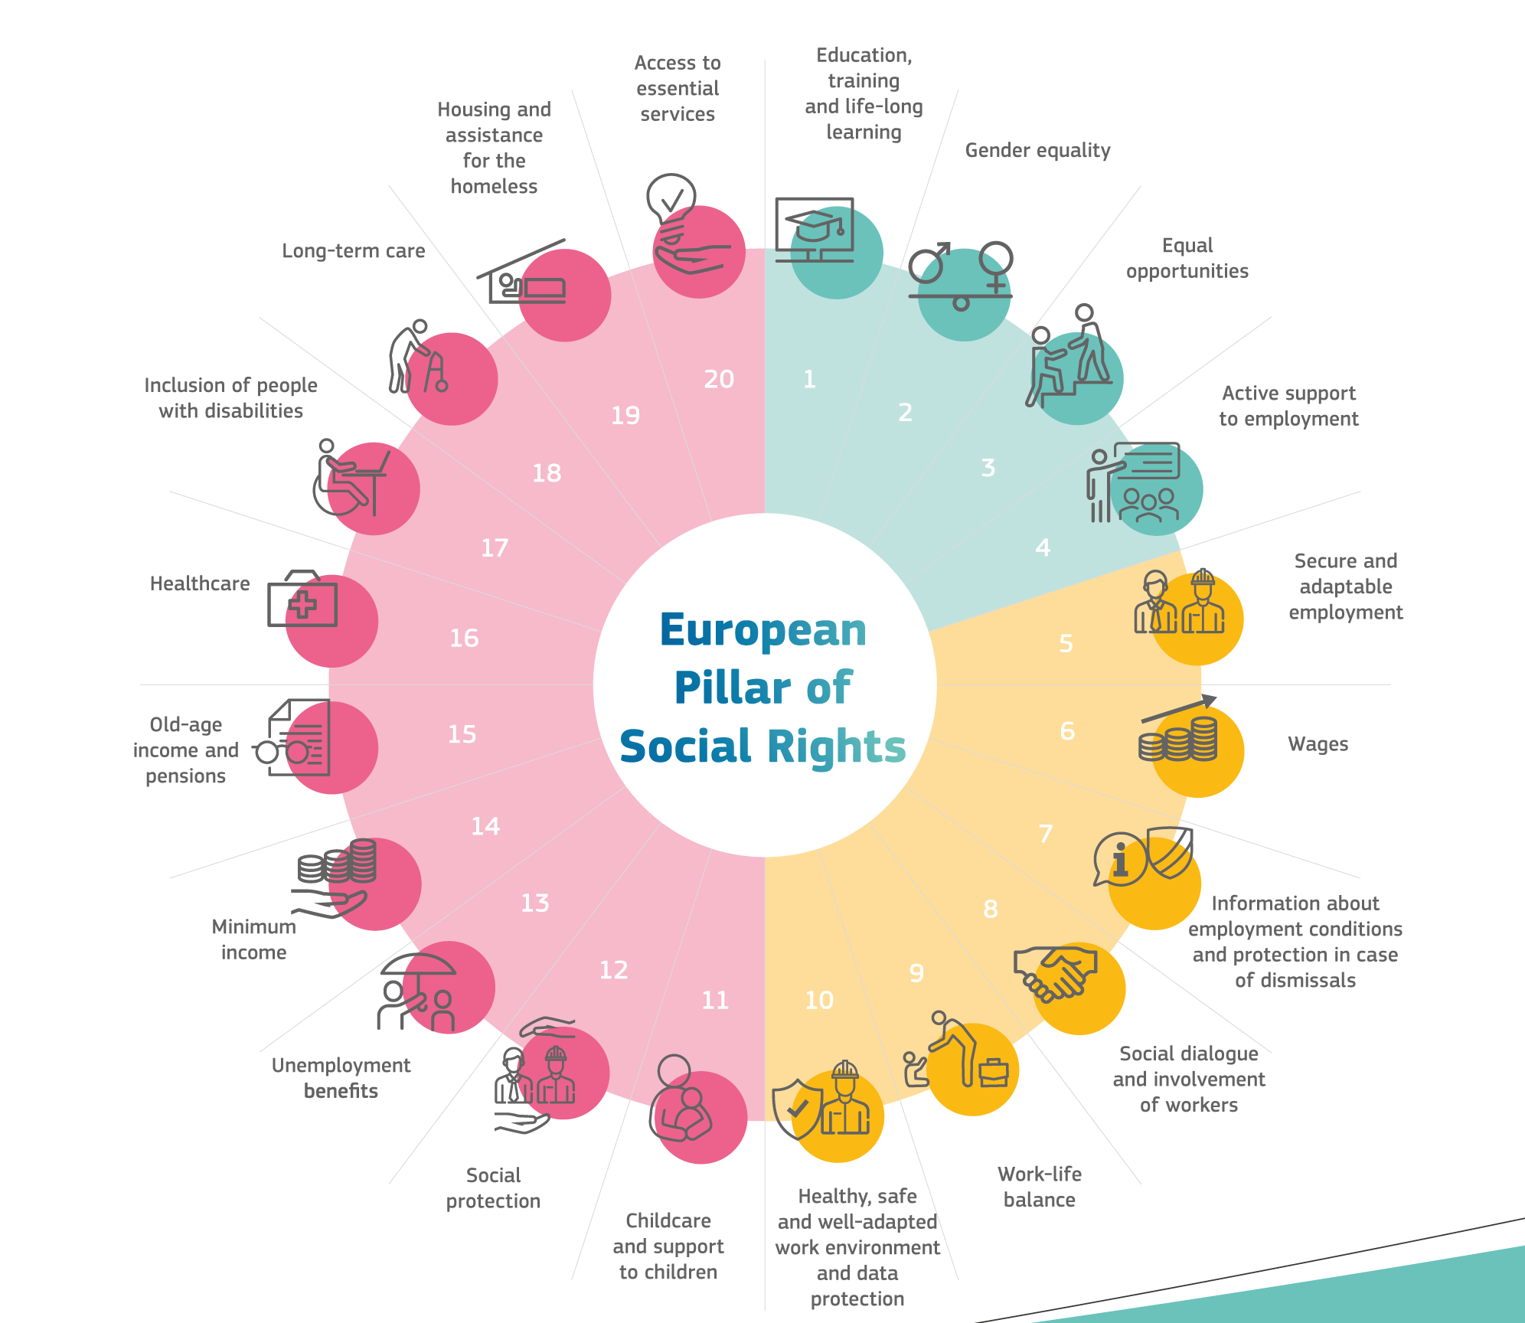
20 Principles of the Pillar
3 Chapters:
Equal Opportunities & Access to the Labour Market
Fair Working Conditions
Social Protection and Inclusion

Slide 5
Slido
www.slido.com
#EPSR
Which of the principles does the work of your organisation relate to?

Slide 6
The Action Plan
3 Headline Targets
At least 78% of 20-64 year-olds in employment
At least 60% of all adults participating in training annually
Launched in March 2021, the Action Plan is designed to create pathways to make the principles of the Pillar a reality.
At least 15 million fewer people at risk of poverty or social exclusion

Slide 7
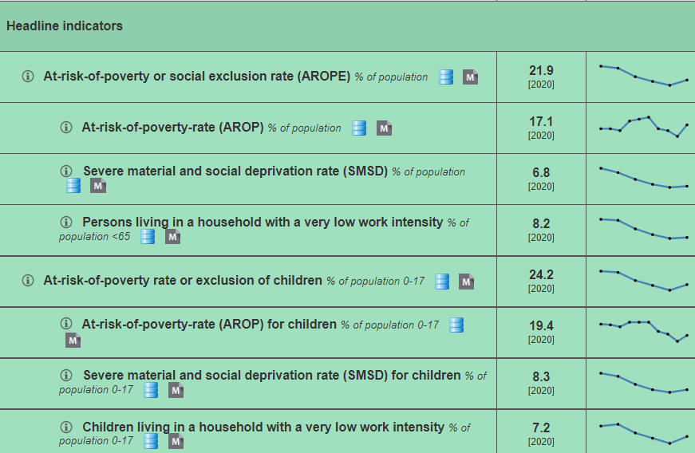
Monitoring Implementation
The European Semester
The Joint Employment Report
The Social Scoreboard
Overview - European Pillar of Social Rights - Eurostat (europa.eu)
Social scoreboard indicators - European Pillar of Social Rights - Eurostat (europa.eu)
https://composite-indicators.jrc.ec.europa.eu/social-scoreboard/
Notes:
LTC in a “focus box” – addressed mainly in view of improving labour market participation of women, not as a right + working conditions not addressed
Child poverty also in a “focus box” – focus on poverty levels and ECEC, no look at specific groups, such as children with migrant background or minorities – Child Guarantee mentioned, but no assessment yet
NEETs/ young people in both documents – numbers rised for the first time in 6 years – migrant background and young women particularly affected – strengthened Youth Guarantee, not a strong focus on outreach
Poverty overall, analysed on basis of AROPE indicators – poverty levels have broadly stayed stable in 2020

Slide 8
Up to you!
Which work is your organization currently doing that relates to any of the Social Pillar principles?
→ Google Jamboard
Notes:
https://jamboard.google.com/d/1YFo8TeAm0fW3MmCZcnHDaSdchWyMjJ1c7KSNey2SOOY/edit?usp=sharing

Slide 9
Up to you!
2. Which are the 3 principles the EU should act most urgently on?
www.slido.com
#EPSR

Slide 10
The Social Pillar Action Plan
Marcello Ranucci
DG EMPL
European Commission
Q & A

Slide 11
The way forward
What can you do?
Identify the key principles on which action is needed in your country
Use the Pillar principles to pressure your governments to act
Ask your government to set up a national coordination mechanism and to be part of it
Share information and analysis with Eurodiaconia
What will Eurodiaconia do?
State of the Social Union Report and Conference (September)
Involved in the European Semester process
Trainings for members on the EPSR and European Semester

Slide 12
Questions or comments ?

Slide 13
Social Europe Academy
Pilot phase – programme for 2022 to be launched soon
Next Webinar:
The Child Guarantee – How to engage at the national level?
26 April 10.00 - 12.00

Slide 14
Thank you for your attention
www.eurodiaconia.org

