Slide 1

Annual General Meeting Bucharest 2024
Capacity Session on European Funding
16 May 2024

Slide 2

Agenda
Introduction to the session
EEA and Norway Grants - Sotiris Laganopoulos, EEA and Norway Grants, Civil Society Officer
Key opportunities in EU and private foundation funding (e.g. EPIM)
IV. Innovative practice -Inese Bulava, Diaconia Center of the Evangelical Lutheran Church of Latvia, Programme Manager
V. Q&A
VI. Workshop- Breakout groups
VII. Plenary reporting
IX. Synthesis, ways forward, and closing

Slide 3

Speaker
Sotiris Laganopoulos
Civil Society Officer, EEA and Norway Grants

Slide 4
Annual General Meeting Bucharest 2024
EU+ funding opportunities for social services
A look at ESF+ SI+, EaSI, Horizon Europe, CERV and EPIM
16 May 2024

Slide 5

Outline
ESF Social Innovation+
CERV
Innovative Approaches on Long-term Unemployment
European Remembrance and Charter
ESF+ EaSI strand
EPIM
EURES Targeted Mobility Scheme
Private foundation pooled fund
Horizon Europe
Missions and Crosscutting issues

Slide 6
EU funds for social services, social innovation
EU Regional Policy (cohesion) funds – all EU regions, for example:
  European Regional Development Fund (ERDF)
  European Social Fund Plus (ESF+)
  Just Transition Fund (JTF)
Employment, Social Affairs and Inclusion- ESF+ and Single-Market Program
Migration and Border Management – AMIF
Culture, Education, Youth and Sport - Erasmus+ and European Solidarity Corps
Civil rights, Liberties and Justice – CERV and Gender equality and equal opportunities in other EU funds
Research, Innovation and ICT; Energy – Horizon Europe
EU Support for Ukraine
Notes:
Cohesion funds - to support job creation, business competitiveness, economic growth and sustainable development, and to improve citizens' quality of life.
European Regional Development Fund (ERDF) - social and economic development of all EU regions and cities;
European Social Fund Plus (ESF+) - jobs and creates a fair and socially inclusive society in EU countries;
Just Transition Fund (JTF) - supports the regions most affected by the transition towards climate neutrality;
Others: The Urban Agenda of the EU (energy transition, housing, inclusion of migrants and refugees, jobs and skills in the local economy, etc)

Slide 7

ESF SI+ Initiative
Facilitates the transfer and upscaling of innovative solutions in employment, education, skills and social inclusion
EUR 197 million (2021-2027)
European Competence Centre for Social Innovation – c/o Lithuanian European Social Fund Agency (ESFA)
2 Streams:
Social innovation grants - EU-level calls for supporting transnational projects that:
  facilitate the transfer and/or scaling up of social innovations including several types of actions
  conceptualise and validate tested approaches
  help to roll out validated models across Europe
  help the social innovation support organizations to improve their capacities
Knowledge-sharing
  Offers mutual learning, capacity building and networking activities for ESF+ Managing Authorities and other relevant stakeholders
  Issues: Employment, Education and Skills, Social Inclusion, Social Innovation, Migrant Integration, Material Support)

Slide 8

ESF+ SI+ Initiative
Innovative Approaches Tackling Long-Term Unemployment – EUR 23 million (indicative)
Transnational projects should focus on:
cooperation with local employment stakeholders and partnerships between local employers and communities,
improving the outreach of long-term unemployed people, including those facing the most barriers,
providing an individualised, accessible, and inclusive approach to long-term unemployed people.
Who can apply: Consortia only
Grant: between EUR 1 000 000 and EUR 3 000 000 per project (co-financing of at least 20% must come from other sources than the EU budget)
Deadline: 17h00 CET, 30 September 2024
Notes:
Objective: to transfer or scale up proven and promising social innovations aimed at the integration of the long-term unemployed into the labour market and fostering their social inclusion.
Grant agreement signature by April 2025

Slide 9

ESF+ EaSI
ESF+ EaSI EURES TMS aims to address skills shortages by helping individuals in accessing transnational job opportunities where their skills are most in demand and in equipping the workforce with the necessary skills.
The activities that can be funded are:
information, matching, recruitment and placement
pre- and post-placement support to customers
direct financial support to candidates to contribute to interview and relocation trip expenses, language training, and recognition of qualifications
direct financial support to SMEs for training programmes for newly recruited individuals.
Deadline date: 04 June 2024, 17h00 Brussels
Open to: Consortia only
Notes:
Opening date: 19 March 2024
Deadline date: 04 June 2024 17:00 Brussels time
Budget: EUR 16 000 000
Who can apply: Only consortia are eligible.
information, matching, recruitment and placement (e.g. innovative approaches and matching/recruitment methods to identify and reach individuals with particular skills, qualifications or profiles in line with the needs of specific labour sectors affected by labour shortages, in identified area)
pre- and post-placement support to customers (e.g., profiling and pre-selection of candidates, assessment of training needs and skills development, providing interview preparation support, offering information and assistance, addressing challenges that may arise during the early stages of employment, regular monitoring and assessing the performance and satisfaction of placed individuals and employers)
direct financial support to candidates to contribute to interview and relocation trip expenses, language training, and recognition of qualifications
direct financial support to SMEs for training programmes for newly recruited individuals.

Slide 10

Horizon Europe: Missions and Crosscutting Issues
Horizon Europe - EU's key funding programme for research and innovation, €95.5 billion budget
Crosscutting issues - horizontal actions , in response to new needs or opportunities and aim to experiment with new approaches
First priority: a set of three actions in support of the five EU Missions, aiming to mobilise the power of social innovation actors and processes.
  1. Coordination and Support Action (CSA) - network to build the capacity of social innovators and entrepreneurs, and impact investors (EUR 2.5 million);
  2. Framework Partnership Agreement (FPA) (no budget)
  3. Specific Grant Agreements (SGAs) to implement the FPA action
Second priority: Experimental actions that address needs expressed by important stakeholder groups in the context of Horizon 2020 and Horizon Europe evaluations
Notes:
FPA - framework to increase the impact of EU funding by attracting additional, non-EU funds in the form of private and public contributions and scale up social innovation projects (no budget); thanks to networked fund holding EU and non-EU contributions
Second priority - (role of universities, research institutes and higher education establishments as organisers and launch pads of local collaborative, transdisciplinary research and innovation activities for the benefit of the missions)
The 5 EU Missions are:
Adaptation to Climate Change: support at least 150 European regions and communities to become climate resilient by 2030
Cancer: working with Europe's Beating Cancer Plan to improve the lives of more than 3 million people by 2030 through prevention, cure and solutions to live longer and better
Restore our Ocean and Waters by 2030
100 Climate-Neutral and Smart Cities by 2030
A Soil Deal for Europe: 100 living labs and lighthouses to lead the transition towards healthy soils by 2030

Slide 11
Horizon Europe: Missions and Crosscutting Issues
European Social Innovation Advisory Network in support of EU Mission Objectives
Expected Outcome:
Social innovation advances the EU Mission societal and environmental transition objectives and recognized as means of achieving EU Missions objectives;
Social innovators benefit from moderated learning and experience sharing and liaise better with projects and support activities;
Establishes the foundation for a networked fund targeting the scaling up of existing, demonstrably successful social innovations
Framework Partnership Agreement for a European Networked Catalyst Fund for Social Innovation in Support of the Missions (duration: 4 years)
Expected Outcome: The action shall strengthen the engagement of social innovation actors including philanthropy in the missions.
Successful social innovation projects will benefit from structured and networked funding environment
Target applicants: Funders of social innovation (foundations, philanthropists, national research and innovation funding agencies, other public bodies, or private investors.)
Notes:
Leveraging social innovation leads to solutions that prove more adapted to society, locally and regionally, as well as more robust. improving the funding environment for the upscaling social innovation in the EU and associated countries.
HORIZON-MISS-2024-CROSS-02-01: Experimental local action for EU missions: knowledge institutions as focal points of transdisciplinary research and innovation activities with European outreach
The consortium may exceptionally be composed of at least three legal entities established in at least one Member State or Associated Country as the nature of the action aims to support collaborative research and innovation activities in a local setting as contribution to an EU Mission.
The coordinator of the project proposed must be a secondary or higher education establishment or a research organisation60
Expected Outcome: Project results are expected to contribute to all of the following expected outcomes:
• Research outputs are taken up in the context of an EU Mission and contribute to the achievement of the Mission’s objectives.
• Universities, other higher education institutions and research institutes – including those not participating in the actions – develop their roles as designers and managers of transdisciplinary608 research and innovation projects, knowledge transfer hubs and enablers of just transitions in the context of the EU Missions.
• The strategies of universities, other higher education institutions and research institutes to contribute to EU Missions developed along the axes of ‘research and innovation’, ‘education, training and skills’ and ‘public engagement and societal impact’.

Slide 12

CERV
Citizens, Equality, Rights and Value Programme Topic 3: Migration, de-colonisation and multicultural European societies
Objectives:
To explore the legacy of colonialism, inside and outside Europe, and its impact on contemporary multicultural European societies.
To raise awareness of Roma history and culture to contribute to strengthening multicultural European societies
To link common European experiences of migration to multitude of events
Activities that can be funded:
Link different types of organisations to create synergies
Develop different types of activities,
Establish and conduct trainings for rights defenders, civil servants, members of the judiciary, law enforcement officials and policymakers;
Provide opportunities for inter-generational exchanges between witnesses and future generations;
Involve people from different target groups and gender
Notes:
Opening date: 05 March 2024
Deadline date: 06 June 2024 17:00:00 Brussels time
also by using new methods of teaching and new technologies;
including, where possible, people facing racism, antisemitism, antigypsyism or other forms of discrimination and intolerance.

Slide 13

EPIM
European Programme for Integration and Migration - Europe’s longest-standing philanthropic collaborative fund (since 2005), 24 private foundations
Thematic Funds:
Shaping the Future of European Migration Governance;
Long-term Prospects and Protection of Children and Youth on the Move in Europe;
Access to Rights for Mobile EU Citizens;
Strategically Communicating on Migration in a Changing Environment; and
Building Inclusive Societies
+ Political Response, Opportunity and Innovation Fund (currently funding projects that address the displacement from Ukraine)
EPIM’s Response to the Ukraine crisis
Funding has transitioned from an emergency response to a focus on building inclusive societies in Central and Eastern Europe (CEE)
The next steps include the funding a CEE collaborative network infrastructure for long-term inclusion and migration governance building on the lessons learnt from the Ukraine response,
Funding the creation of a Slovak consortium/network interlocutor of migration-focussed organisations (in addition to bilateral grants that EPIM will continue to provide)
Notes:
Objective: strengthening the role of civil society in building inclusive communities and in developing humane and sustainable responses to migration, based on Europe’s commitment to universal human rights and social justice.
By 2024, 2024, EPIM becomes the European Philanthropic Initiative for Migration, fund and nurture alliances and partnerships, curate the
migration ecosystem and cultivate a shared narrative for belonging and democratic resilience
EPIM supports and strengthens civil society organisations (CSOs) working on issues of
migration and integration at the European level to:
Uphold and defend the European commitment to universal human rights and
social justice, to ensure the dignity of all people in the European Union;
Promote gender-sensitive, inclusive and pragmatic approaches to European
and national policies on migration and integration;
Influence EU policies and their national implementation in areas
defined in EPIM’s sub-funds.
Strengthening advocacy capacities of these organisations is central to its support
model. EPIM does this by:
Enabling national CSOs to bring their knowledge and best practices
to the EU level;
Encouraging national CSOs to partner across the EU in order to build
effective coalitions for advocacy and to share experiences;
Assisting pan European CSOs to take advantage of national experiences
to develop European solutions to core challenges.
In 2023, it spent EUR 2.6 million, 80% as grants awarded to CSOs, total of 119 grants
Opportunity and Response Funds - Ukraine 63%
Future of Migration Governance 15%
Strategic Communications 8%
Children on the Move 7%
Inclusion 4%
Intra-EU Mobility 3%

Slide 14
EPIM
New frame - migration and its interconnection to a broader set of societal changes like addressing inequalities, strengthening civic infrastructure and the rule of law, combating polarisation and othering, and creating spaces for belonging. Migration as a multifaceted issue – holistic solutions that address root causes and promote social cohesion
Beyond inclusion – work alongside migrants to shape their communities and participate in decision-making processes
5 Themes
Dignified work and housing
Political response, opportunity and innovation fund
Shaping the future of Europe’s migration governance
Building inclusive societies in CEE
Emerging thematic clusters
2024 - EPIM will provide eligible partners with transition/closing grants, ranging between EUR 20K and 30K (depending on the size of the organisation’s average annual budget)
Notes:
Pathway to Change – 4 Action Pillars
Building bridges and strengthening ecosystems
Changing perspectives and narratives
Centring lived experiences
Reimagining funding

Slide 15


Upcoming activities (2024)
Basic Funding Training – 21 and 26 June 2024
Advanced Funding Training – September 2024
Funding Network – November 2024

Slide 16







www.eurodiaconia.org
Thank you!
Any questions?
+32 (0)2 234 38 60
office@eurodiaconia.org
Rue Joseph II 166, 1000 Brussels
Co-funded by the European Commission under the ESF+ programme 2022 - 2025. The information contained in this document does not necessarily
reflect the position or opinion of the European Commission. Copyright 2024.
Eurodiaconia All rights reserved.

Slide 17
Speaker
Inese Bulava
Programme Manager, Diaconia Center of Evangelical Lutheran Church of Latvia

Slide 18





TRAINING MODULES FOR PEER SUPPORT TO REFUGEES FROM UKRAINE
Inese Bulava
inese.bulava@diakonija.lv

Slide 19
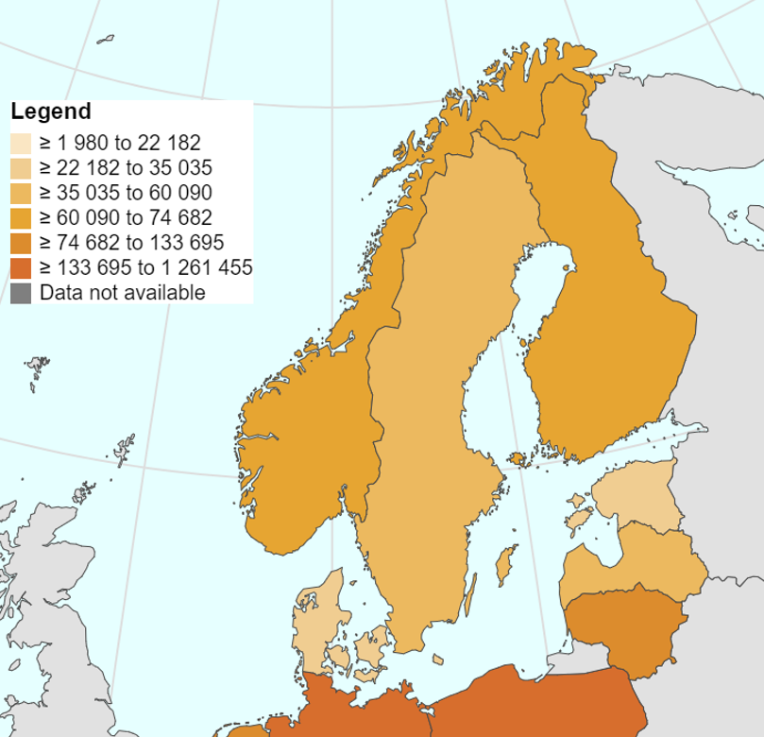
CONTEXT: WAR IN UKRAINE
UKRAINIAN REFUGEES IN EUROPE
(Lack of) regional cooperation
Number of Ukrainian refugees in Latvia, Estonia, and Finland (Eurostat: March ‘24)
Ukrainians supporting other Ukrainians
Psychological issues
Language integration & cultural background
Job & education challenges
Online realities and opportunities

Slide 20

Nordplus Adult
Collaboration Projects
Project Management 4000 € / 2000 €
Transnational Meetings 630 € pp per meeting
Development Work 125 € / 250 € per day
  Development/Mapping/Network
Average: 2 years, 3 - 4 partners, 50.000 EUR
Denmark, Norway, Sweden, Finland, Iceland
Baltics, Åland, Faroe Islands, Greenland
Notes:
. Here are some questions to ask to gain insights into their preferred information sources and formats:
Information Sources:
What sources do Ukrainian refugees commonly rely on for obtaining information?
Are there specific websites, social media platforms, or community networks they frequently engage with?
Do they access information through local organizations, government agencies, or refugee support networks?
Language and Accessibility:
What languages do Ukrainian refugees prefer for receiving information?
Are there language barriers that need to be addressed in the e-learning materials?
Are there any specific accessibility requirements to consider, such as translation services or audio-visual support?
Visual and Multimedia Preferences:
How do Ukrainian refugees respond to visual content such as images, infographics, or videos?
Are there specific visual styles, colors, or layouts that resonate with their cultural background?
Do they engage more effectively with multimedia presentations or interactive content?
Written Information:
How comfortable are Ukrainian refugees with reading and comprehending written information?
Do they prefer shorter, concise texts or more detailed explanations?
Are there any literacy or language proficiency challenges to consider?
Community Engagement and Social Learning:
Do Ukrainian refugees value peer-to-peer interactions and learning from others?
Are there existing community support groups or networks where they share information and experiences?
How can social learning and collaboration be incorporated into the e-learning materials?
Familiarity with E-Learning Platforms:
Are Ukrainian refugees familiar with using e-learning platforms or online educational resources?
What level of digital literacy do they possess?
Are there any barriers or challenges to accessing and utilizing e-learning platforms?
Feedback and Interactivity:
Do Ukrainian refugees appreciate opportunities for providing feedback and engaging in discussions?
Are interactive elements such as quizzes, assessments, or discussion forums preferred?
How can the e-learning materials encourage active participation and reflection?

Slide 21

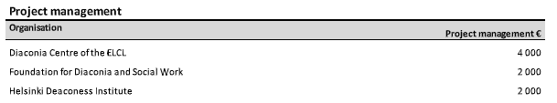
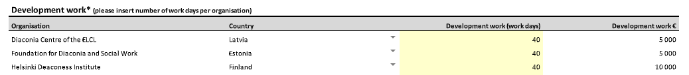
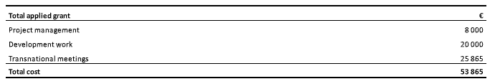
  First payment: 80%

Slide 22





FIVE MODULES
Module 1: Introduction to Mentoring Ukrainian Refugees
Module 2: Trauma-Informed Approach and Cultural Competency
Module 3: Education, Training, and Career Development
Module 4: Advocacy, Networking, and Community Support
Module 5: Self-Care and Mentor Well-being
Importance of self-care for mentors
Strategies for managing stress and preventing burnout
Establishing boundaries and seeking support when needed
Overview of the mentoring role and responsibilities
Understanding the needs and challenges of Ukrainian refugees
Effective communication and active listening skills
Understanding trauma and its effects on refugees
Culturally sensitive approaches in mentoring
Promoting mental health and well-being
Language tensions
Learning language
Exploring educational opportunities and pathways
Supporting mentees in skill development and training
Providing guidance in career exploration and goal setting
Empowering mentees to advocate for their rights and needs
Building supportive networks and connections
Engaging with community for additional support

Slide 23
TRAINING MODULES FOR PEER SUPPORT TO REFUGEES FROM UKRAINE
May 2023 - November 2024
Developing e-learning experiences for and with Ukrainian experts by experience
Needs analysis reports
Professional profile of a mentor
Core curriculum
Five tested e-modules, and supporting material, including videos, questionnaires, and checklists
  Freely available outputs online in ENGLISH and UKRAINIAN

Slide 24

INNOVATIVE (?) ACTIONS AND APPROACHES: NORDPLUS EVALUATION RESULTS
«A project that aims to help war-affected people with a model that can be used in other future crises.»
«To help people integrate into society and provide tools to make people employable.»
«Particularly positive is the strong emphasis on the needs assessment phase prior to development of any material.»
«It is also positive that the output will be developed together with they call "Experts by experience" as well as other stakeholders.»
«The peer-mentoring seems positive for the sense of security and stability.»
«The partnership will train and supervise the mentors and provide mentoring programs and other services to refugees while using and continuously developing the materials of this project, and they have a good plan for dissemination and spreading the results.»
«The e-learning program is well described and involves an extensive and well thought through plan.»
«It will be published online so that it is also possible to access without having to start in a course if not wanted.»

Slide 25
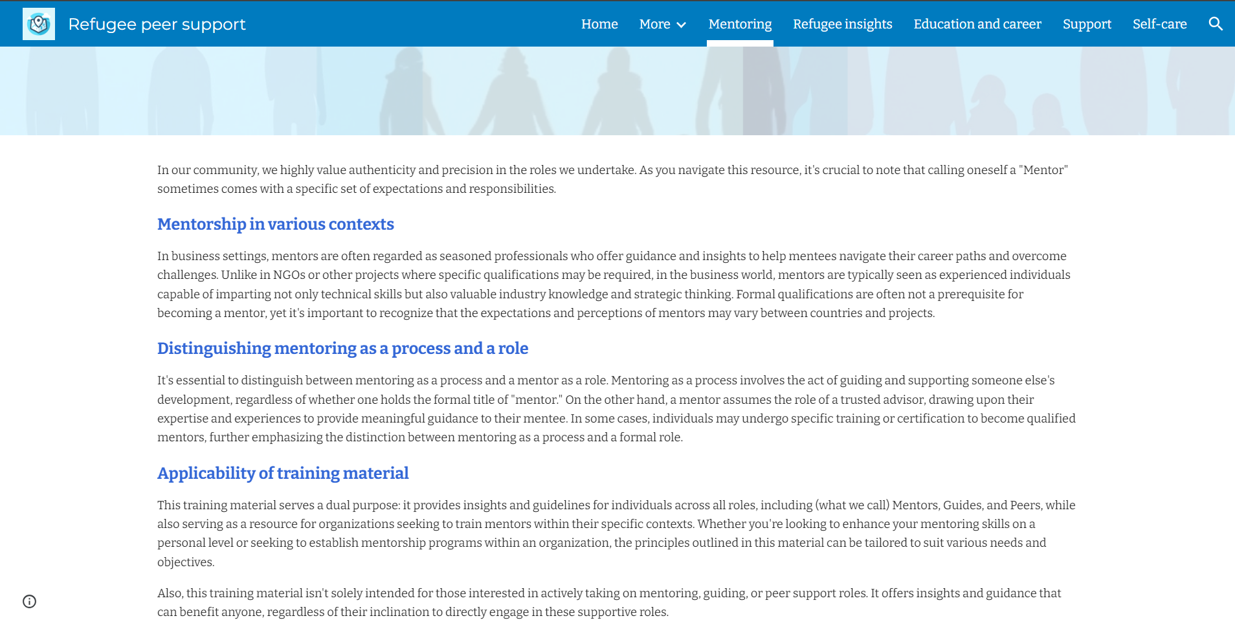
OUTPUTS
* Needs analysis reports from each country in English
* Professional profile of a mentor in English
* Core curriculum in English
* Five e-learning modules in English and Ukrainian (learner input: approx. 30 hrs)
* Supporting content in English and Ukrainian (videos, questionnaires, checklists etc.)
* E-learning piloted informally with at least 30 Ukrainian experts by experience in each country
* Dissemination activities: at least 10 publications of e-learning content (incl. in Ukrainian, in English,
and in local languages) in each country
* Project webpage with all content
* Relevant content published on Wikipedia, Youtube, and Moodle

Slide 26
LESSONS LEARNED
Nordplus is simple to manage and great to develop partnerships
Simple planning and reporting, yet also very little money
Hobby project for staff?
Do not overpromise but strive for a quality «product»
Monthly online meetings despite frequent onsite meetings
Fixed costs for meetings: plan locations wisely
Everything is changing: extending expiry date of project results
Sustainability of project results and continuation?
What is our motivation when looking for funding?

Slide 27
TRAINING MODULES FOR PEER SUPPORT TO REFUGEES FROM UKRAINE
Inese Bulava
inese.bulava@diakonija.lv

Slide 28
Questions and answers

Slide 29
Breakout groups
In 3 groups, please discuss and answer the questions below (20 minutes). Please use the flipchart, markers, stick notes. There will be a short plenary reporting afterwards so please assign a rapporteur.
1. What challenges do you face in accessing European funding for social services and social innovation?
2. What are your good practices in accessing European funding?
3. What would be your strategy/ies on European funding in the next three years?

Slide 30
Plenary Reporting and Synthesis

