Slide 1
Annual General Meeting Bucharest 2024
Communicating Diaconia
How personal stories can contribute to shaping narratives and reinforcing the image of Diaconia, especially online.
16/05/2024
Speaker:
Donal Brady

Slide 2
Table of contents
Introduction
Anatomy of a Personal Sory
Ice-breaker and Intros.
Content
Your turn
Communications Challenges
Work alone or in pairs to create a Personal Story campaign
Addressing a challenge
Dissemination
BRIDGES project and results
Case Study: Freedom from Torture (UK)
Case Study
Discussion and review
Peter McVerry Trust's Personal Story "James' Story"

Slide 3
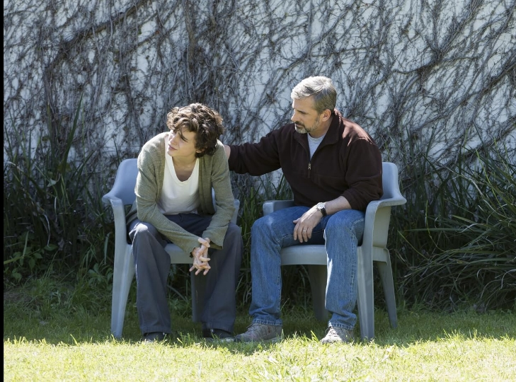
Hello, I am Delightful Donal!
Ice-breaker Introductions
Right now, my favourite story is a movie called “Beautiful Boy” (2018)

Slide 4
Ice-breaker Introductions
Think of an adjective that describes you.
If it starts with the same letter as your name, even better! Ask the person beside you for help if you are struggling!
What’s your favourite story? Film, book, media campaign
Other examples:
Happy Heather
Optimistic Olli

Slide 5
Finding your content
Write down one or two projects or initiatives from your organisation that you would like to highlight as a campaign.
Describe the project to the person next to you

Slide 6
Addressing a
challenge: BRIDGES
BRIDGES is an academic publication (2024) which aimed to understand how facts turn into narratives and narratives into individual and collective responses.
BRIDGES focused on the causes and consequences of migration narratives, and looked not only at migration narratives as such but also and particularly at the processes behind them.
The results showed that the stronger you identify with the protagonist, the more deeply you think about this person and their story, and the less counterarguments you think of in processing the story.
The results suggest that it is more important to create compelling, memorable narratives that move individuals to connect with the protagonist. Who is telling the story, or the cultural group of the protagonist seem rather secondary.

Slide 7
Addressing a
challenge: BRIDGES
Other findings:
Readers who felt a stronger connection with the protagonist of the story were more likely to share this story with others on the internet, to volunteer their time, and to contribute financially to help all migrants.
A story that shows clear examples of discrimination and victimisation can make you intensely angry while also increasing your empathy for the person suffering these injustices.
On the other hand, a story of heroism and overcoming adversity can generate self-transcendent emotions, such as making you feel moved and in awe. In both cases, these effects lead to attitudinal changes involving more positive views towards migrants and greater intentions to help them.

Slide 8
BRIDGES Conclusion
Story-telling can positively shape narratives.
Audiences engage with personal stories, regardless of who is telling them.
Personal stories can extinguish counter-arguments.
Personal stories can activate audiences positively.
So... let's use stories!

Slide 9
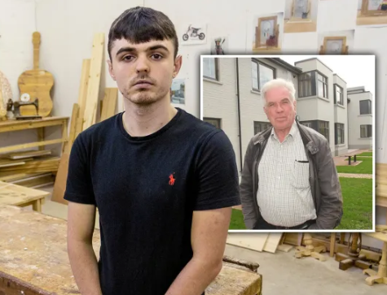
Case study: Peter McVerry Trust James' story
Background:
Peter McVerry Trust is homeless and housing organisation in the Republic of Ireland. It was founded by a Roman Catholic priest from the Jesuit Order, Fr. Peter McVerry in 1984.
The charity publishes 4 Personal Stories a year. One of its services is a Learning Centre for teenagers who have left mainstream education called CMS.
This campaign tells "James' story" a 15-year-old boy who left mainstream education and enrolled in the learning centre.

Slide 10
Case study: Peter McVerry Trust James' story

Slide 11
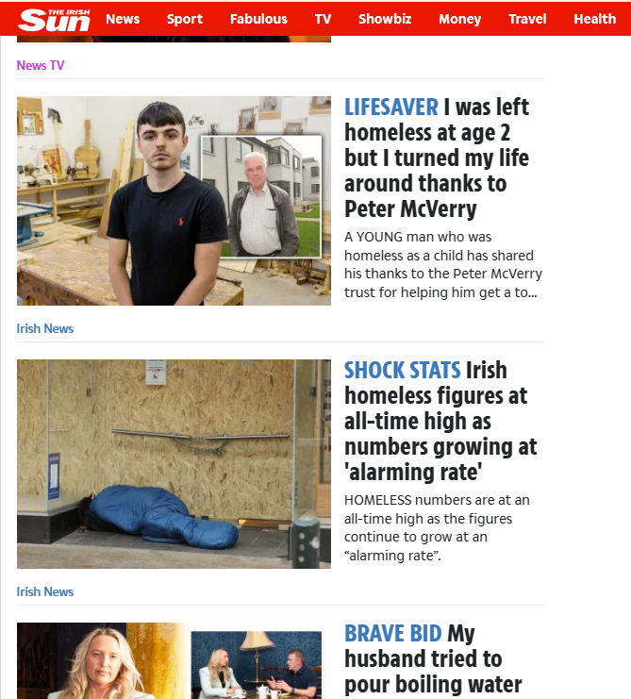
Traditional Media and Social Media
"TV news is more consistent across channels, with a particular inclination towards emotive reporting." (BRIDGES, 2024)
"Social media, often stereotyped as a breeding ground for xenophobia and conspiracy theories, presents a polarized site of political contestation. Messages arousing high-activation passions, whether anti- or pro-immigrant, are favoured by algorithmic selection. However, social media rarely introduces new narratives" (BRIDGES, 2024)

Slide 12
The anatomy of a Personal Story
Context
Problem
Turning Point
Emotion & Action
What are the very basic details the audience need to know?
What challenge/problem/obstacle did the protagonist face?
What happened that changed the challenge/problem/ obstacle into a success?
What emotion is the audience left with? What action can the audience take?

Slide 13
Crafting your organisation's "Personal Story"
Here are some key points to remember:​
Remember what you aim to achieve; is the aim to raise awareness or a call to action (sign-up, donate here, speak up etc.)?
Your organisation or project or service was THE TURNING POINT
You should aim to disseminate the Personal Story across various media; a newsletter, your website, your social media channels and, if possible, traditional media such as local radio, newspapers, TV.
Establish your Key Performance Indicators (KPIs); what is success and what are we measuring?
Now it's your turn!

Slide 14
Activity
Complete the worksheet with some short, high-level, points.
It should take you around 10 minutes.
You can work on your own or in a group.

Slide 15
Dissemination Case Study: Freedom from Torture (UK)
As a subscriber to their newsletter, I received an email from Freedom from Torture with the subject "Elija's story is one I won't forget..."
The newsletter was only 211 words long.
It had 5 hyperlinks (3 to the full story, 2 to the donate page).

Slide 16
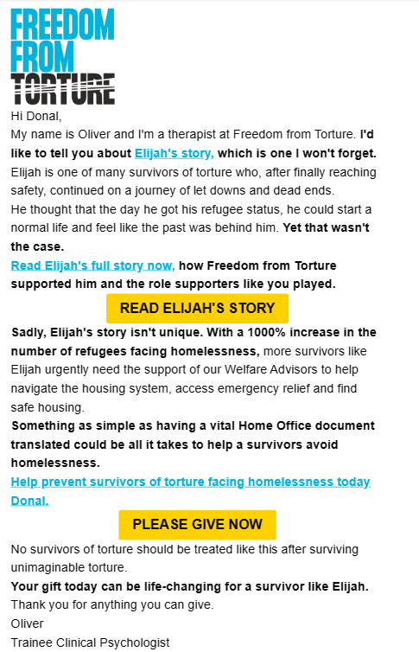
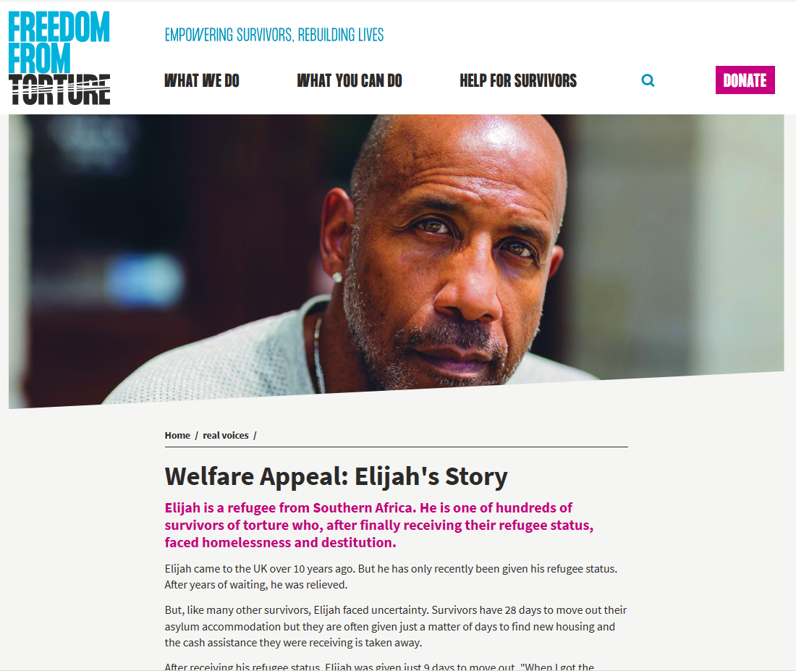

Slide 17
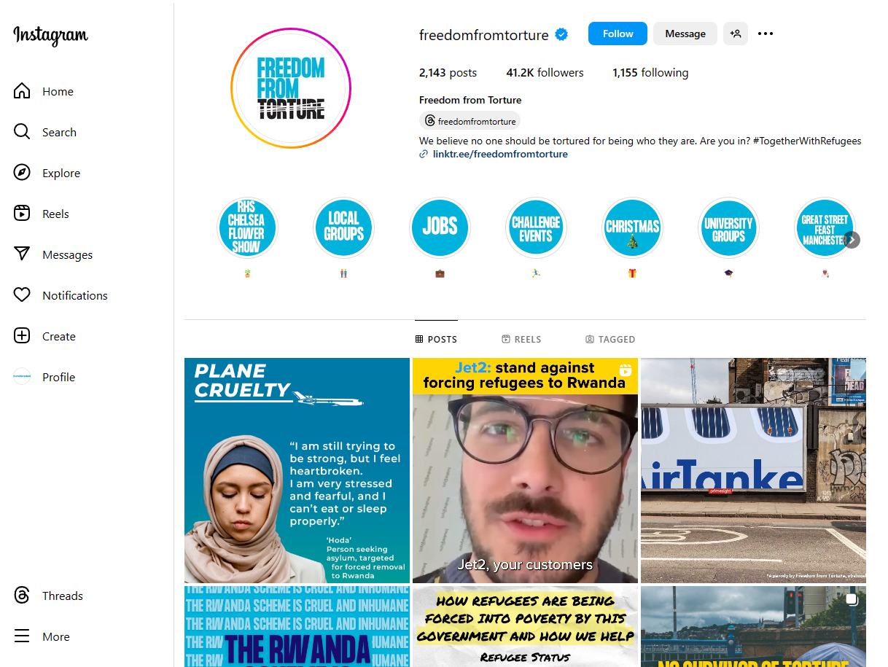

Slide 18
Other story-telling points
Overcoming the monster, Rags to riches, The Quest, Voyage and Return, Comedy, Tragedy, Rebirth
Order of events, story-telling in chronological order
Narrator
and
protagonist

Slide 19
Discussion and Review
What communications challenges did the use of Personal Stories campaigns address?
What support would you need to make what's on your page a reality?
Any other questions or remarks?
Final questions... Who remembers the "Ice-breaker"? What’s your favourite story now?

Slide 20
www.eurodiaconia.org
Thank you, any questions?
+32 (0)2 234 38 60
office@eurodiaconia.org
Rue Joseph II 166, 1000 Brussels
Co-funded by the European Commission under the ESF+ programme 2022 - 2025. The information contained in this document does not necessarily
reflect the position or opinion of the European Commission. Copyright 2024.
Eurodiaconia All rights reserved.

