Slide 1



"For I know the plans I have for you," declares the Lord, "plans to prosper you and not to harm you, plans to give you hope and a future."

Slide 2
Why Start Debt Aid Buddy in the Netherlands
2008 financial crisis - increasing number of people in poverty
Increased reliance on church emergency aid
Deepening and widening of poverty
50% of those seeking help have debts
Debt trap
Rising societal costs
Debts are costly
726,000 households with problematic debts
Europe: Netherlands approximately 14% of residents at risk of poverty

Slide 3
Transformation of the Diaconal Role of Churches and Christian Organizations
Development of a new diaconal concept
Coalition of churches and entrepreneurs
Coaching people in debt through skilled volunteers
Empowerment as a principle
Not just giving the fish but teaching how to fish
Providing perspective: a sustainably financially healthy life
A hopeful future, light in the darkness
Core values: reciprocity, respect, honesty, being a Buddy
Experience stories to break the taboo on debt
Preventive help via online platforms

Slide 4
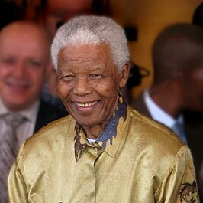
"Combating poverty is not an act of charity. It is an act of justice. It is the defense of a fundamental human right, the right to dignity and a decent life" – Nelson Mandela

Slide 5
Effect – building bridges of trust with people, partners en governments
Growth in collaboration with local churches
Growth in collaboration with local governments
Influence on local policy, strengthening the voice of marginalized people
More active and visible role of local churches in the community
Connection between Christians and volunteers from other groups
60% of our aid seekers not recognized by the government
Annual increase in volunteers, including those with personal experience
Hundreds of thousands reached online
Tens of thousands coached through a Buddy

Slide 6
Impact
Participants experience respect, regain self-confidence, become more financially healthy
Connection between social layers in our society
Bridging the gap created by growing division
Breaking negative perceptions about people with debts
Churches playing a more active, visible, and professionally valued role in society
More influence with local governments and national ministries
Innovations to circumvent the debt industry through the use of data

Slide 7
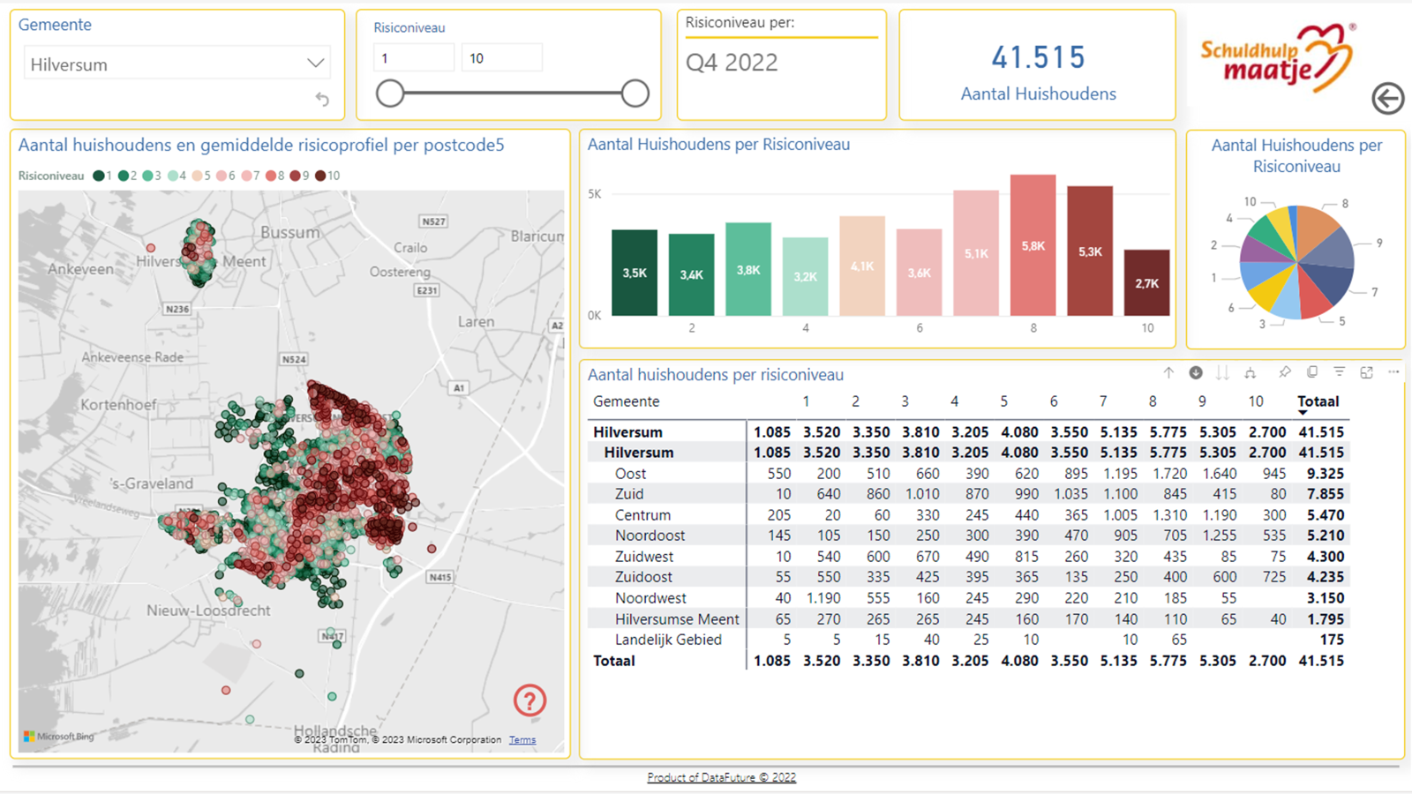

Slide 8

Second round
"If you want to be perfect, go, sell what you own and give the money to the poor; then you will have treasure in heaven."

Slide 9
Recommendations - Relevance and Credibility?
Churches
  Money plays a major role in everyone's life, rich and poor. How do we prevent money from controlling our lives? How do we distribute our wealth, so no one is shortchanged?
  Biblical principles of stewardship
  Preventing debts is better than curing them: focus on prevention
  Churches' role at life crossroads remains significant
  Working with stakeholders to improve living situations
  Churches' role in addressing injustice is at the core of your mission

Slide 10
Society
  Increase in polarization, elections fueled by anti-migration sentiments
  Backlash against neo-liberal policy, based on distrust
  Rising basic costs (housing, groceries, energy)
  Growing group of working poor
  Due to decentralization, more development of local poverty policies
  Inequality in approaches between municipalities
  Civil society as a powerful engine
  Opportunity for churches to mobilize many based on a passion for charity

Slide 11
Effort
  Work closely with those affected daily
  Drop-in places in the neighborhoods where they live, listen to their stories
  Obtain a mandate as churches and Christian organizations to take action
  Collaborate with entrepreneurs
  Start a volunteer initiative with people from various social layers
  Involve stakeholders so they have opportunities for development
  Take a professional approach, so you are recognized as a serious party by governments

Slide 12
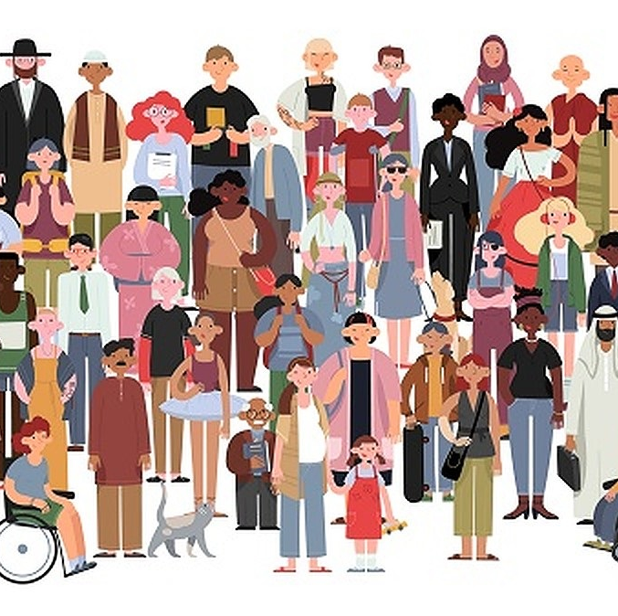
"The quality of society can be measured by how much compassion we have for those in distress."

Slide 13
What We Must Do (third round)
Build strong local alliances with local churches, entrepreneurs, interest groups, and colleague organizations
Collaborate and share stories of people with experience to break stereotypes and empower others in poverty
Lobby against wrongful collection practices with strong allies like the National Ombudsman and Consumer Association
Leverage the Jubilee Year in 2033 for a major debt pardon?

Slide 14
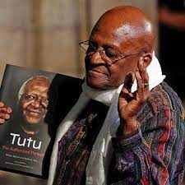
Connection is the Medicine Against Loneliness (Desmond Tutu)

