Slide 1
Societal implications of labour market instability
Eurodiaconia Annual Conference and General Meeting
14 May 2024, Bucharest
Eszter Sandor
Senior Research Manager, Eurofound, Unit C – Social Policies
esa@eurofound.europa.eu

Slide 2
What do we mean by labour market instability?
Non-standard employment: temporary contracts, part time, self-employment
  At higher risk of (periods of) unemployment
  Issue only if it is involuntary, i.e. no other job is found
Platform work (not the focus of the report, but mentioned throughout)
Informal work: no contract, or contracted for lower pay/fewer hours than actual work
  Lacking protection offered by employment law: unfavourable working conditions and high insecurity
Underemployment: working fewer hours than desired, or at lower skill/qualification level

Slide 3
Previous literature: social outcomes of labour market instability
Related to feelings of social exclusion (identity, status)
Discouragement (if unable to find a stable job)
  – research has focused mostly on young people’s need for inclusion through work – looming unemployment results in loss of human capital, delay in household formation, increase in emigration
  while older workers (45+) are less likely to lose job, once they do it is harder for them to find a job, leading to discouragement
Increased gender disparity: women feel more unsettled when working on a fixed-term contract, regardless of position
Impact on physical and mental health: both through immediate shocks and prolonged stress
Impact on quality of society: less studied, but potential loss of trust in people through social exclusion, and turn to extreme political views, has been suggested

Slide 4
Data sources
  LFS 2021 microdata: social groups most likely to work in non-standard arrangements, levels of labour market attachment by country
  Eurostat – trends in temporary employment, underemployment and other forms of unstable labour market attachment
  ESS Round 9 (2018) – pre-pandemic data on trust in people, opinions about government/society
  Eurofound’s e-survey (2022) – links between contract type, working hours, job insecurity and societal outcomes

Slide 5
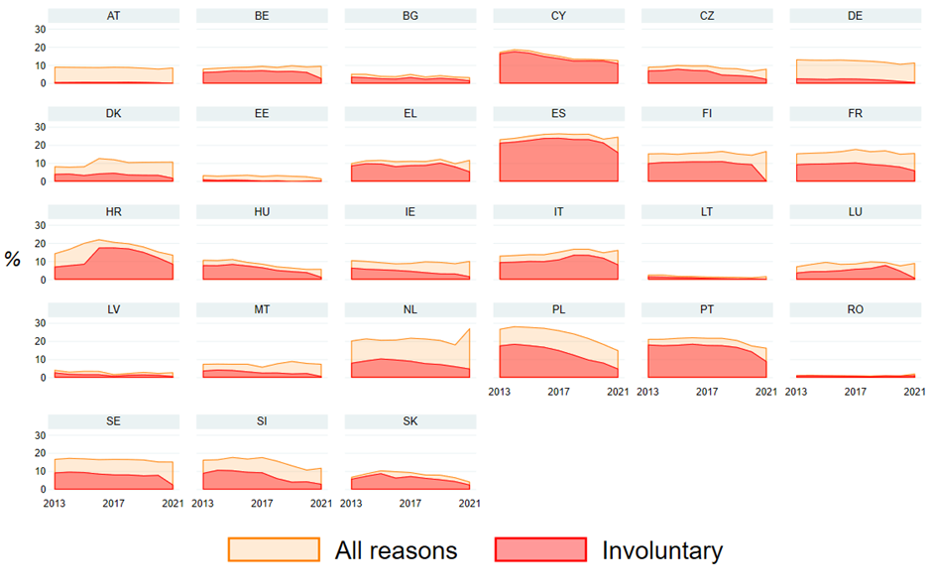
Temporary contracts: main findings from LFS 1.
Temporary work by reason, 2013-2021
Fixed-term contracts tend to be involuntary
Decrease in fixed-term contracts during the pandemic shows the vulnerability of sectors that use them most (hospitality, retail)
Most affected groups:
  Young people
  Non-nationals
  Single, no children
  Men
  Living in cities
  Lowest and highest educated (healthcare, education)

Slide 6
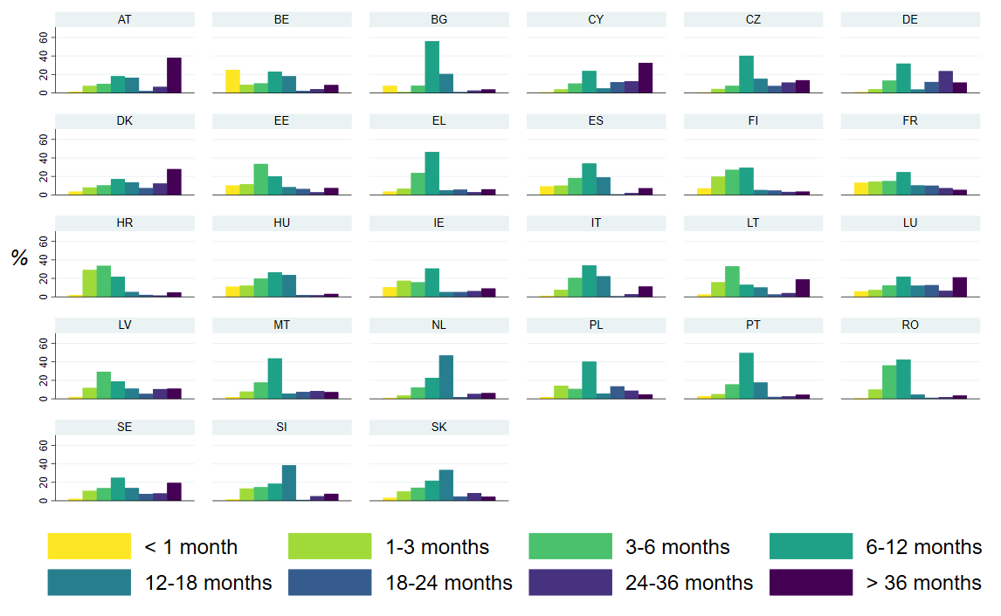
Temporary work: main findings from LFS 2.
Temporary employees tend to:
Work longer hours
Feel underemployed
Be looking for another job
Typical length of contract differs by country.
Austria, Germany: more likely to be voluntary, and have 2+ year contracts
Croatia: mostly involuntary, and 1-3 months is common (seasonal employment)
Temporary work by length of contract

Slide 7
Relationship between wellbeing, contract type and working hours
No relationship between part time work and lower wellbeing found, after controlling for income, gender and other related variables (on the other hand, long working hours are associated with lower wellbeing)
Also, having a fixed-term contract was not associated with lower health, mental wellbeing, or higher social exclusion, once controlling for other variables (although temporary agency contracts were associated with higher risk of depression and lower life satisfaction)
However, a strong link was found between perceived insecurity of job (feeling that one might lose their job within a few months) and wellbeing

Slide 8
Perceived job insecurity is related to lower mental wellbeing
Risk of depression, based on WHO-5 mental wellbeing score, by risk of losing one’s job, 2022

Slide 9
People who think their job is at risk feel social exclusion similar to those unemployed
“I feel left out of society”, by unemployment and likelihood of losing job
Workers whose job is insecure are 11 pp more likely to feel socially excluded, after controlling for other variables

Slide 10
People on insecure contracts have lower trust in other people
Trust in people (scale 0-10) by social groups, regression estimates
Possibly related to feelings of social exclusion
Disability, unemployment, and low income are also related to lower trust in people
European Social Survey 2018

Slide 11
…and lower perception of fairness
Perception of other people’s fairness(scale 0-10) by social groups, regression estimates
Disability, education level and income are strongest predictors of perceiving fairness in society
Relationship with non-permanent contract is also significant after controlling for these factors
European Social Survey 2018

Slide 12
Post-pandemic e-survey data on trust in people
Trust in people (scale 1-10) by social groups, regression estimates
More recent data confirms that certain insecure contracts, such as agency contract or no contract, is related to lower trust
Relationship is strongest with job insecurity

Slide 13
Satisfaction with the government and democracy
No significant relationship between contract type and satisfaction with government, or with trust in government
People on agency contracts or no formal contract are less satisfied with the way democracy works
Those in the lowest income quintile are the least satisfied with democracy, while those in the highest are significantly more satisfied
European Social Survey 2018

Slide 14
Voting behaviour
(among those eligible to vote)
People with less secure contracts are less likely to have voted in the latest elections (among those eligible to vote), especially those with no contract (informal jobs)
Unemployed people and those in the lowest income quintile are also less likely to vote
European Social Survey 2018

Slide 15
Summary
The perceived likelihood of losing one’s job, rather than contract type, has a negative relationship with workers’ well-being
However, for measures of quality of society, both job insecurity and contract type matters: those on non-permanent contracts have lower perception of fairness, and lower trust in others. This is demonstrated both in pre-pandemic ESS data and from 2022 e-survey data.
Government satisfaction seems to be unrelated to labour market instability, as long as the respondent is working.
However, those with insecure jobs, or on non-permanent contracts have lower satisfaction with democracy, and they are less likely to have voted in the previous elections.

Slide 16
Conclusions
The finding that people with some atypical working arrangements, often resulting in high job insecurity, have less trust in other people, and have a sense of unfairness and lack of satisfaction with the functioning of democracy, are also less likely to participate in voting is important. It signals disengagement, which is related to lower wellbeing and higher social exclusion. Notably, people who are not eligible to vote are unable to have their voices heard, and they are also overrepresented among people with the least secure contracts.
Overall, finding the right balance between enabling flexibility and encouraging entrepreneurship, while avoiding the negative consequences of unstable work on wellbeing, social exclusion, and quality of society, remains a challenge for both national and EU level policymakers.
While pandemic-related insecurities have subsided, new challenges brought on by the sustained increase in less regulated, but more precarious forms of work (such as platform work), and the cost-of-living crisis, need to be tackled by European policies, while considering the different circumstances of Member States when it comes to different forms of work.

