Slide 1

Roma Feminist
Community Intervention
The S.O.R.A. method

Slide 2
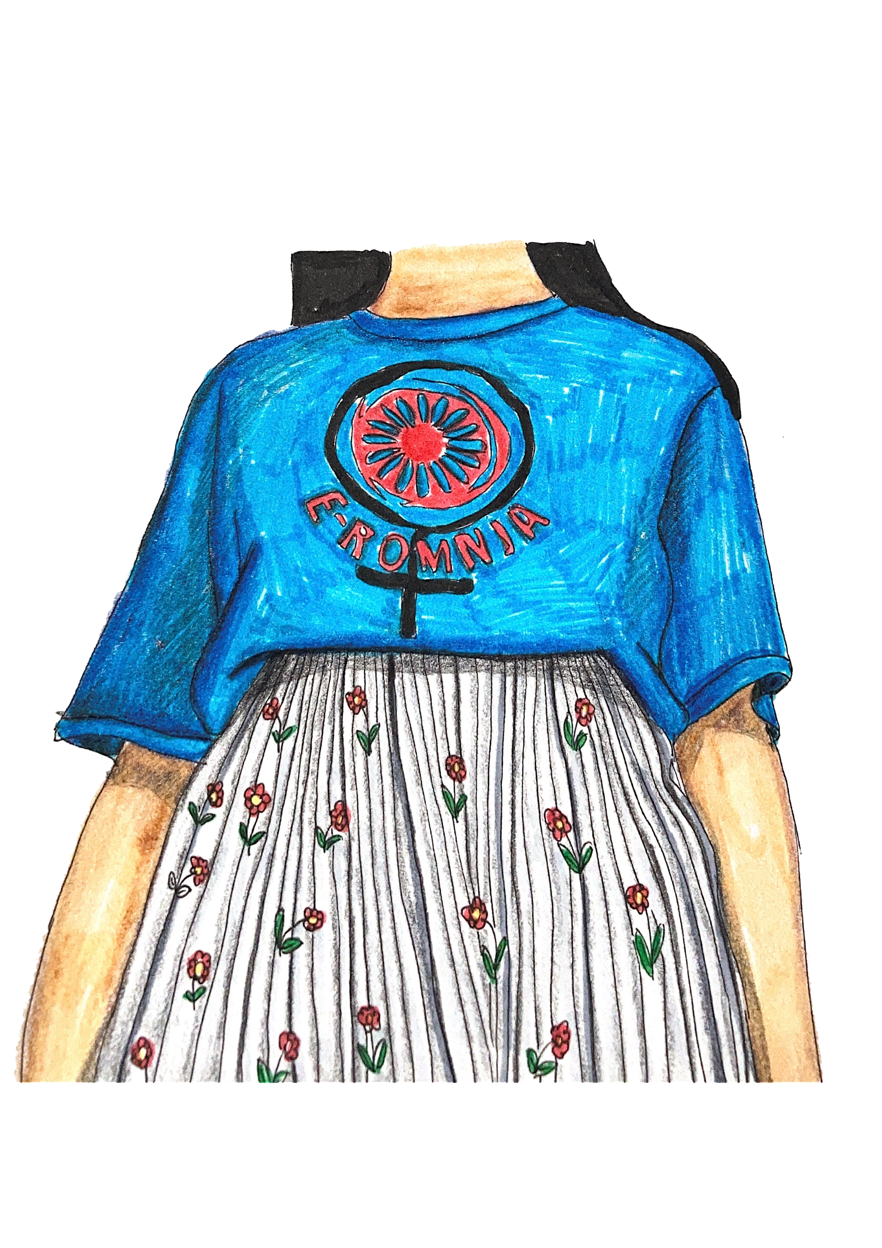
Because we believe that our approach must start from the grassroots to the national level to meet both the urgent needs and to act on the institutional system, we have developed in the last years of work the S.O.R.A. method as a model of feminist community intervention. This method implies performing four essential steps, as follows:

Slide 3
STUDY:
it is a phase of analysis, learning, and sharing of women's experiences (inequalities, abuses, violence, etc.) in which we identify the needs of the community

Slide 4

ORGANIZATION:
a step in which we develop local initiative groups of Roma women. At this stage, we organize workshops, discussions, informal gatherings through which we prioritize community issues and advance adapted strategies. This stage encourages Roma feminist leadership and promotes role models of women's involvement in the community.

Slide 5

REVENDICATION:
at this phase, the groups we work with organize different public, community, local actions for various issues. Women in the groups are also starting to follow the work of local government and local politicians, as well as local projects that should include their communities.

Slide 6

ADVOCACY:
this represents the final stage in which we create contexts for dialogue and collaboration with local actors from various structures, starting from actions built by Roma women. We organize advocacy actions for various local problems encountered by women, from lack of local infrastructure, lack of access to water, services, and utilities to lack of access to healthcare, violence, etc.

