Slide 1
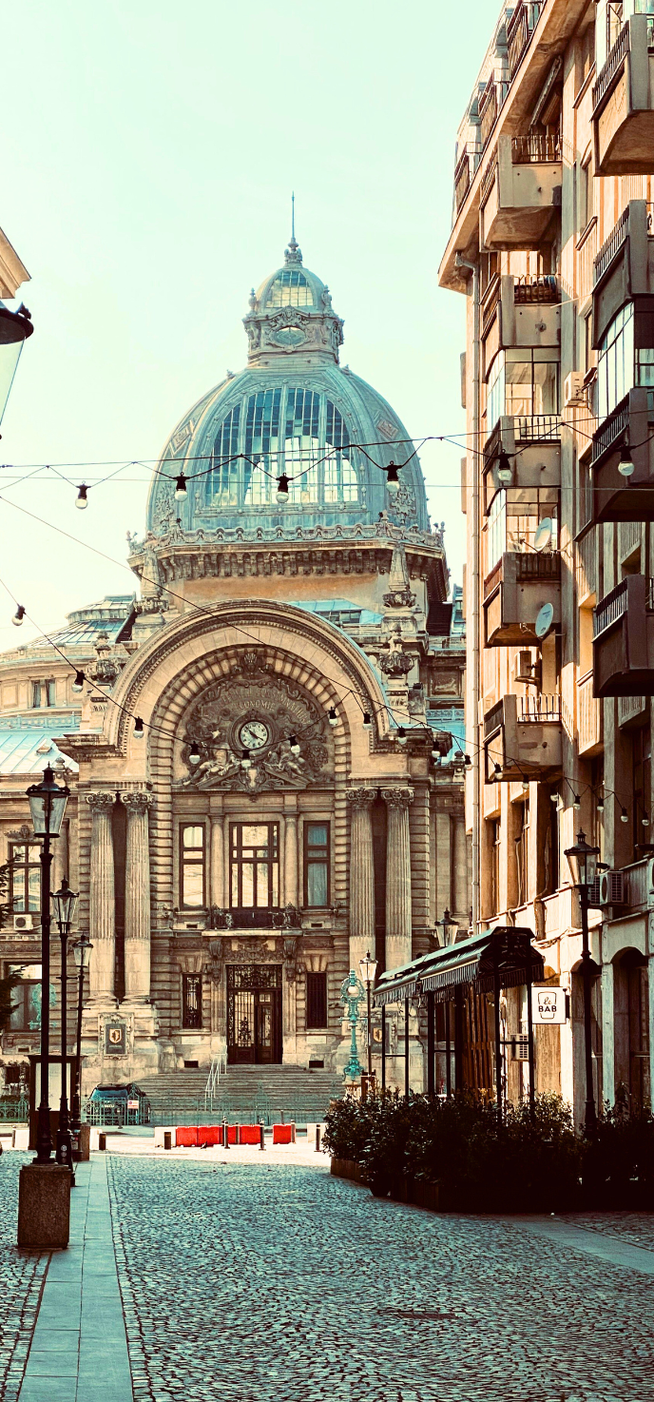
Annual General Meeting Bucharest 2024
Speaking from the margins

Slide 2


Speaking from the margins
Why this workshop?
What does it mean to speak from the margins?
Challenges for diaconal organisations
From service providers to partners?
Notes:
How can diaconia support, develop and make space for voices from the margins? What does it mean to make space? Are we ready to give up someof our space? Building on the theological and biblical contexts such as the open table we will look at power dynamics, participation and empowerment.

Slide 3
Speaking from the margins
Why this workshop?
Notes:
How can diaconia support, develop and make space for voices from the margins? What does it mean to make space? Are we ready to give up someof our space? Building on the theological and biblical contexts such as the open table we will look at power dynamics, participation and empowerment.

Slide 4
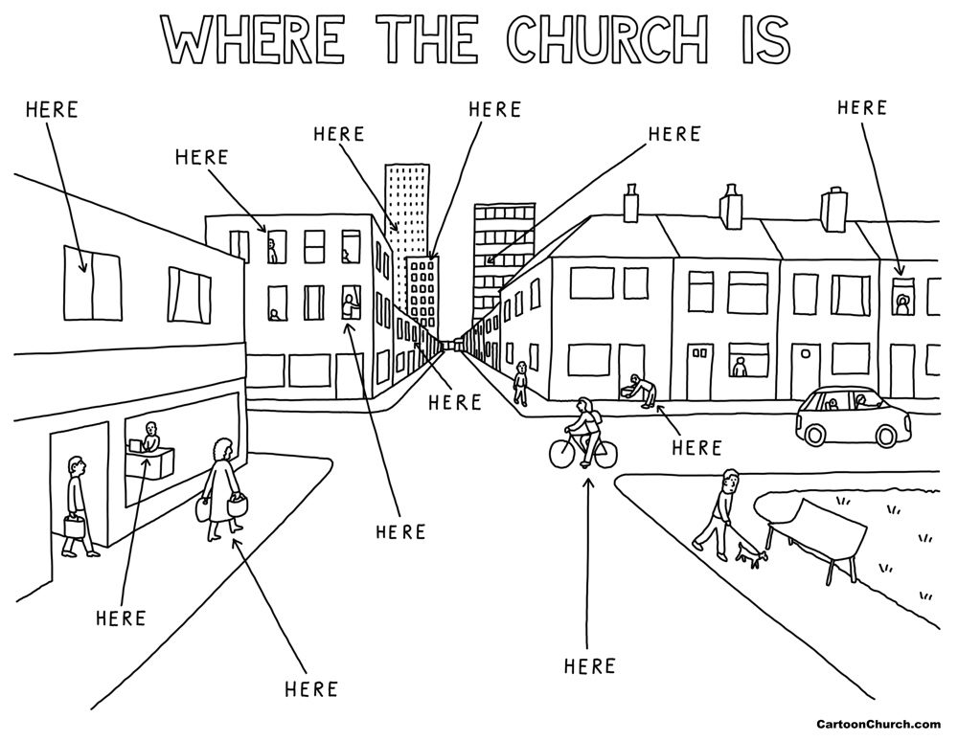
Where are the margins?
Notes:
Where are the margins in your societies? Write on post it notes

Slide 5
Speaking from the margins
What does it mean to speak from the margins?
Better policy making
Better inclusion
Better democracy
Better modelling of Christ – Christ went to the margins and stayed with people in the margins – He did not bring them to the centre immediately
Notes:
Try to avoid the you to us mentallity

Slide 6
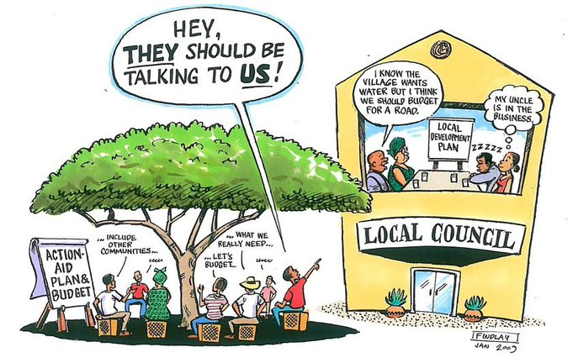
Speaking from the margins

Slide 7
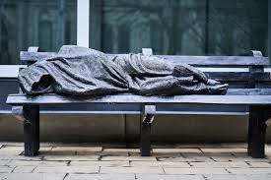
Speaking from the margins
Notes:
Sculpture Homeless Jesus by Timothy Schmalz

Slide 8
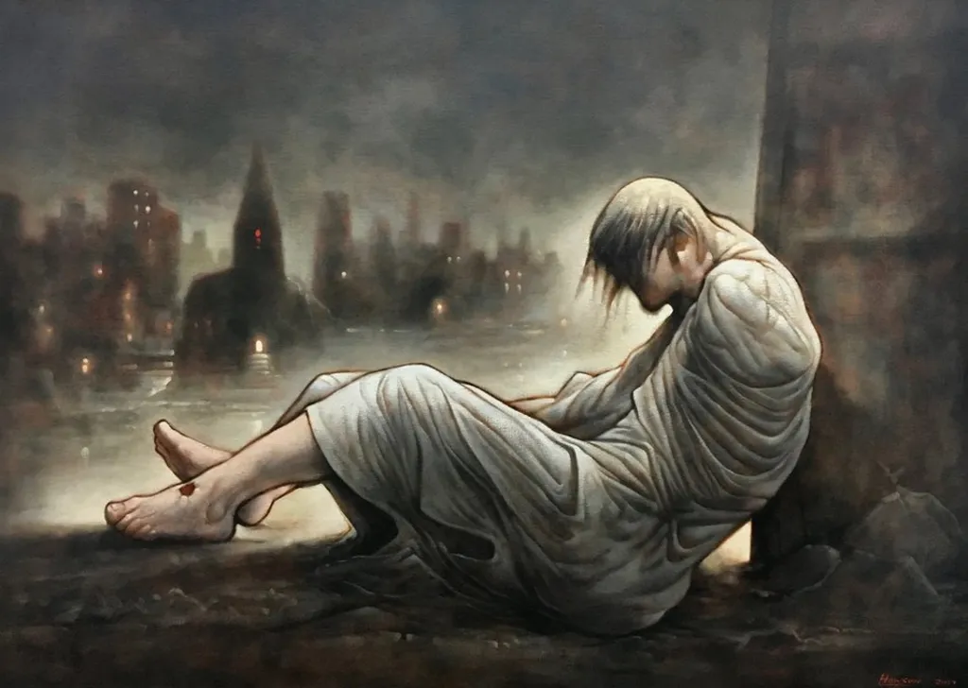
Speaking from the margins
Notes:
Painting Peter Howson
Only Jesus due to the wounds on his feet

Slide 9
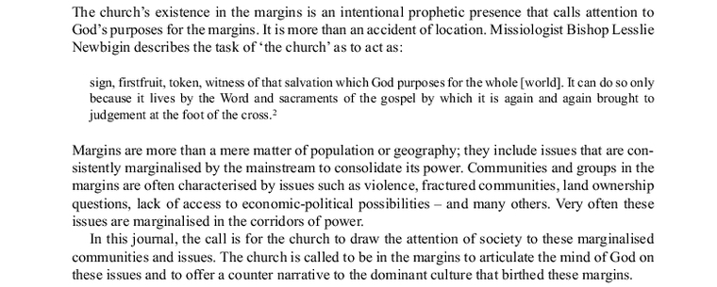
Speaking from the margins
Can prophecy be heard from the margins?
https://www.jstor.org/stable/26696443
Jayakumar Christian

Slide 10
Speaking from the margins
https://www.redshoeswalking.net/prophets-the-uncomfortables/ Glenn Loughery
Where and Who are our prophets?
Prophets are outsiders living in the marginal space from which a different perspective is gained. Why? Marginal spaces do not align with nor are subsumed into the predominant power system or structure of a given society, institution or place. Prophets become a nuisance to those who have vested interest in the maintenance of power or control.
Prophets are not expedient people. They don’t play politics. They are not interested in policy, quoted positions or white papers. It is not about legislation or a win-win. It is simply about the way it is. (Peter Woods, I Am Listening, 2012.) Peter Woods suggests that “Prophetic witness and personal or political expediency do not have a good history of co-existence.”
Prophets are mirror bearers. They hold up a mirror to the world, situation, or person and ensure it is seen for what it is. The emperor has no clothes. The mirror provides the way into seeing how God sees things, not as we imagine we see them.
Notes:
Life is uncomfortable for prophets because prophets are uncomfortable people to be around.
In the rest of our reading Jesus makes it clear that this will be the experience of the disciples as they go out into the world. They are not to mitigate against this response by taking with them the resources to be independent. They are to experience, fully for themselves the cost of being faithful to the prophetic ministry. They will make others uncomfortable and will be made feel uncomfortable as a result.
It is interesting here, both Jesus and the disciples are to be seers, for that’s who prophets are. Being disciples requires us to see through the pretences of the world and to see what is real and evident. People often ask me what it means to be an artist and I am beginning to find an answer, it is to embrace a way of seeing that is different to others, that sees not just the items on the landscape but the address beneath them – it is to see in a way that pares back the superficial and paint only what is there.
And it is a brutal way of seeing because it begins to see into life, ordinary life and the way society lives it and begins to see how much of our lives are built on or around pretences. A recent experience at a coffee shop where we went for lunch shows how this affects you. I looked at the menu, most of the descriptions ran 2 lines long and included ingredients I had no idea what they were. I only wanted lunch. I wanted food, real food, not food that has been invented and is by its nature pretentious. All I wanted was a burger with meat patty, salad and sauce and a bread roll. I thought as I looked at the line up of people waiting to get in how we pretend by what we eat, where we live, what we drive, where we holiday to be sophisticated and mature as a people, and perhaps as a nation, yet we still lock up refugees, take children from Aboriginal families and can’t do reparation for the stealing of this country.
Mark then adds following todays reading the story of John and Herod as a case study, just in case his readers haven’t caught on to what it means to be a disciple.
Mark’s Story:
Mark suggests, by placing the story here that the disciples via their relationship with Jesus:
Are prophetic. It is not a choice. That has already been made. It is now a vocation to be lived.
Are to avoid the political and the expedient. They are not to get caught up in the culture and to compromise or negotiate.
Are to tell it like it is and if people ignore them to simply shake the dust off their shoes and move on.
Like the disciples, we are called to be prophets because we are one with Jesus through his death and resurrection. It is an imperative, not an option.
To fulfil our calling we are to develop a unity with God through word and sacrament, contemplation and prayer. Here we will let go of ideas, positions, ideologies and begin to become one with God. It happens slowly and will begin to find ourselves stepping further into the margins as we let go of the expectations of our culture and society.
To fulfil our calling we are to simply live out of that unity. We are to live our lives and by doing so our lives will speak forth God’s seeing.
In conclusion:
This is not a safe and happiness inducing vocation – we will be outsiders, marginalised for our vocation. We will lose our jobs, be bullied and ostracised, be over looked and sidelined. This is not about ideology but about seeing the world as God does. We are to seek to live on the margins as change only ever comes from the edges, rarely from the centre.
As an individual and as a congregation we are to live prophetically, avoiding the accepted pretences of society all around us and speak into the world through our thoughts, words and actions. A tough job, but we have to be it, especially on this NAIDOC Sunday.

Slide 11
Speaking from the margins
Challenges for diaconal organisations
What makes it difficult for us?
What might we lose?

Slide 12
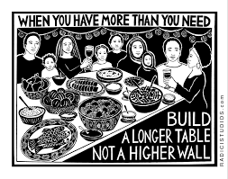
Speaking from the margins

Slide 13
Speaking from the margins
The view from Austria

Slide 14
Speaking from the margins
From service providers to partners?

Slide 15







www.eurodiaconia.org
Thank you!
+32 (0)2 234 38 60
office@eurodiaconia.org
Rue Joseph II 166, 1000 Brussels
Co-funded by the European Commission under the ESF+ programme 2022 - 2025. The information contained in this document does not necessarily
reflect the position or opinion of the European Commission. Copyright 2024.
Eurodiaconia All rights reserved.
Notes:
Close the meeting

